Slide 1
CAPSTONE PROJECT
Indian Premier League data analysis
Presented By:
P. SakthiVel
Sree Krishna College of Engineering
Mechanical Engineering

Slide 2
OUTLINE
Proposed System/Solution
System Development Approach
Algorithm & Deployment
Result
Conclusion
Future Scope
References

Slide 3
PROPOSED SYSTEM/SOLUTION
The Indian Premier League (IPL), a cricketing spectacle that has captivated millions of fans across the globe. Officially known as the Vivo Indian Premier League for sponsorship reasons, this professional Twenty20 cricket league was established by the Board of Control for Cricket in India (BCCI) back in 2007, with the inaugural season commencing in 2008.
The data analysis covers the years 2008-2019,we'll be exploring data from the early seasons of the IPL. During these years, various iconic moments, matches, and performances occurred, contributing to the league's establishment as a premier T20 competition. Teams like the Mumbai Indians, Chennai Super Kings, Rajasthan Royals, and others participated in these seasons.

Slide 4
SYSTEM APPROACH
Building the proposed solution would involve a combination of data processing, feature engineering, and machine learning. Here are the key system and library requirements
System Requirements:
A computer with sufficient processing power, preferably with multiple cores or a GPU for faster training of machine learning models
Adequate RAM to handle the size of the dataset and computational requirements.
2. Software:
An operating system compatible with the required machine learning libraries (e.g., Windows, Linux, mac OS).

Slide 5
ALGORITHM & DEPLOYMENT
Regression Analysis: Regression models can be used to analyze the relationship between various factors (such as player performance, team strategies, match conditions) and outcomes (such as match results, player scores, team rankings). Linear regression, logistic regression, and other regression techniques can be applied depending on the nature of the data and the specific research questions.
Clustering: Clustering algorithms such as k-means clustering can be used to group similar players, teams, or matches based on various features or attributes. This can help identify patterns and trends in the data and discover interesting insights.

Slide 6
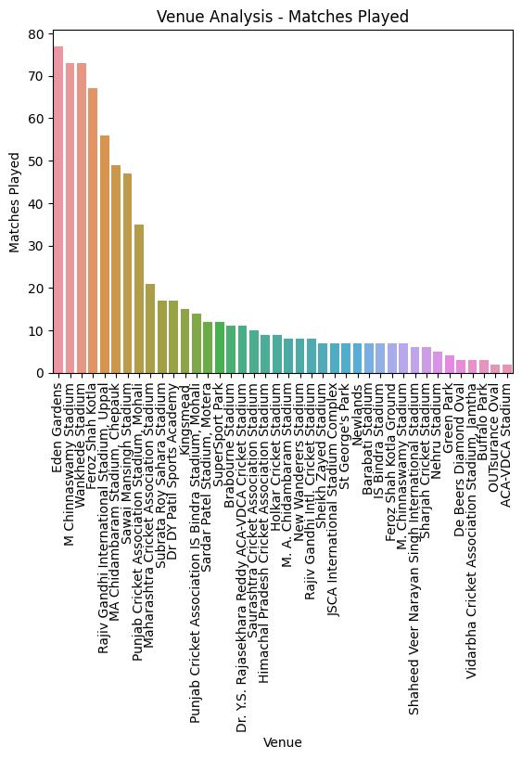
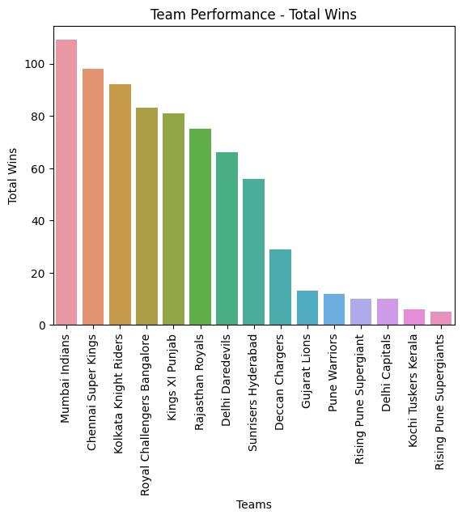
RESULT

Slide 7
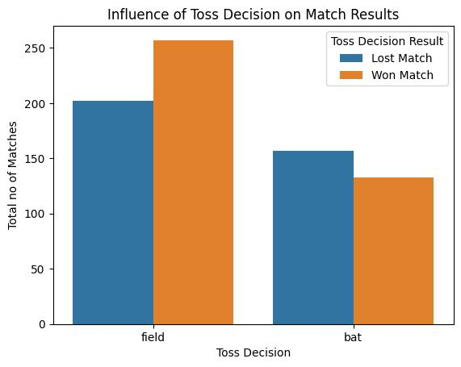
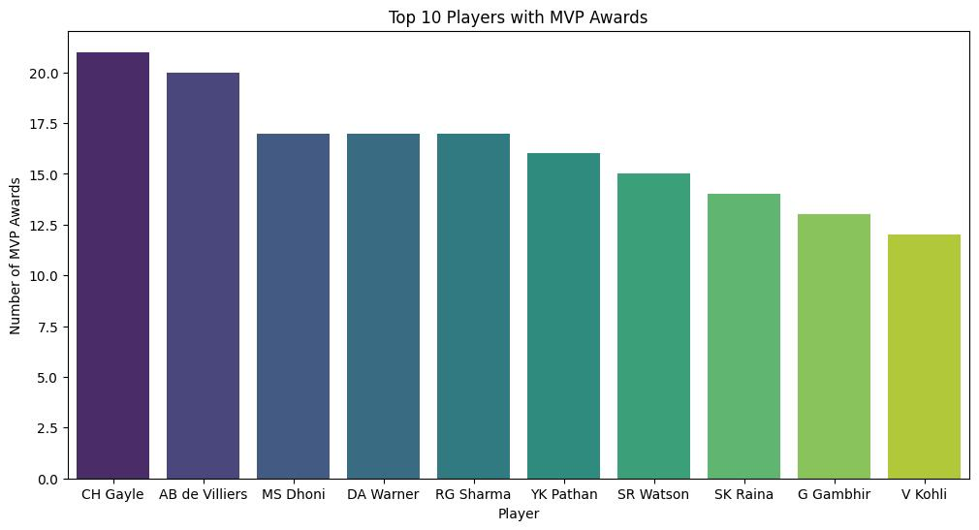
RESULT

Slide 8
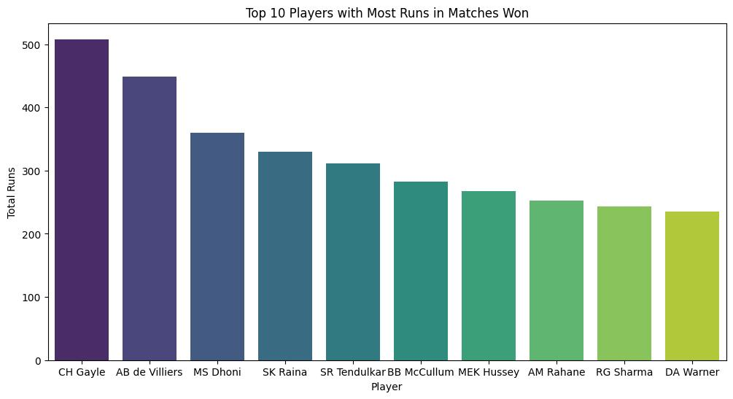
RESULT

Slide 9
CONCLUSION
Team Performance: Teams like Mumbai Indians and Chennai Super Kings have been consistently successful, with multiple championship wins. On the other hand, some teams have struggled to maintain a competitive edge throughout the years.
Match Outcomes: Close matches and high-scoring encounters are common in the IPL, showcasing the competitiveness and entertainment value of the tournament. Additionally, the home-ground advantage plays a significant role in determining match outcomes.
Player Statistics: Players like Virat Kohli, Rohit Sharma, and AB de Villiers have consistently performed well across seasons, while bowlers like Lasith Malinga and Sunil Narine have been dominant in their respective roles.

Slide 10
FUTURE SCOPE
Predictive Modeling: Using machine learning and data analytics techniques, future IPL data analysis could focus on developing predictive models for match outcomes, player performances, and team strategies. These models could help teams make informed decisions during matches, auctions, and player selections.
Performance Optimization: Advanced analytics techniques can be used to optimize player performance, team strategies, and game tactics by analyzing player fitness data, match conditions, and opposition strengths and weaknesses.
Revenue Generation: Leveraging data analytics to optimize revenue streams through ticket sales, merchandise, sponsorships, and broadcast rights can help teams and stakeholders maximize their financial returns from the IPL.

Slide 11
REFERENCES
https://www.kaggle.com/datasets
https://youtu.be/GsfT2sv_zCo?feature=shared

Slide 12
THANK YOU

